Slide 1
Implementing e-navigation and operator workload
Todd Schuett, Innovation Projects Manager
Kongsberg Norcontrol

Slide 2
This presentation at a glance
Introduce SESAME Solution II
The operator workload hypothesis
A proposed solution to decrease workload

Slide 3
Project background
Extend the original SESAME testbed to include the following:
Automated electronic ship reporting
Just-in-Time Arrival Service
e-navigation services
Decision support
Harmonized Display of Navigation Information received via Communications Equipment (HDNICE)
Human-centered design
Cost-benefit analysis
Notes:
Automated electronic ship reporting to a Maritime Single Window (IMO e-navigation SIP Solution 2)
Just-in-Time Arrival Service (coordinated with berths, tugs and pilots)
e-navigation services
Decision support (behavior analysis, hot spot detection),
Harmonized Display of Navigation Information received via Communications Equipment (HDNICE)
Human-centered design
Cost-benefit analysis

Slide 4
Human factors
How can the system design promote trust in automation?
Does automated electronic ship reporting reduce administrative burden?

Slide 5
Project objectives
Reduced Administrative Burden
Digitized ship traffic management
Shared Situational Awareness
Collaborative Decision Support

Slide 6
The consortium
MAROFF program
25.3 mNOK budget
10 mNOK funding
Q1 2018 – Q1 2021

Slide 7
SESAME e-navigation services
Provided by an authority
Provided by a commercial entity
Automated Ship Reporting
Just-in-Time Arrival
Recommended Route / Pilot Route
Hot Spot Detection
Marine Safety Information
Traffic Congestion
Route Monitoring
Route Cross-Check
Behavioral Analysis
Weather Routing
Route Optimization
Chart Updates

Slide 8
SESAME II testbed
Yara Birkland
Wilhelmsen
Massterly
DFDS Seaways
Three Norwegian VTS Centers
Port of Southampton
Dover CNIS
Port of Singapore

Slide 10
This presentation at a glance
Introduce SESAME Solution II
The operator workload hypothesis
A proposed solution to decrease workload

Slide 11
Workload vs. burden
Workload is the demand placed on an operator’s mental resources used for attention, perception, reasonable decision-making and action (skybrary.aero)
Burden is something difficult or unpleasant that you have to deal with or worry about (cambridge dictionary)
In other words: they are related but different concepts

Slide 12
VTSO Workload & e-navigation implementation An hypothesis
High
Workload
Low
With a low level of implementation, route exchange ship-to-shore will increase workload onshore
Voyage planning onboard involving route sharing ship-to-shore and automated reporting will add new tasks
Low Level of Implementation / Adoption High

Slide 13
The current situation
Will workload increase? Decrease? Or stay the same?
New tasks can result in increased workload
Administrative burden has not been benchmarked in a precise manner

Slide 14
This presentation at a glance
Introduce SESAME Solution II
The operator workload hypothesis
A proposed solution to decrease workload

Slide 15
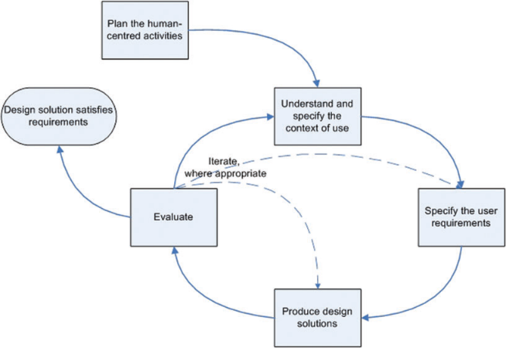
The SESAME solution:
Human-centred design ISO 9241-210:2010 IMO e-Nav guideline MSC./Circ. 1512 (2015)
Human factors research and Human Centered Design
Benchmark the current administrative burden for reporting
Introduce new technology and measure the change, if any
Design the system and software using HCD principles

Slide 16
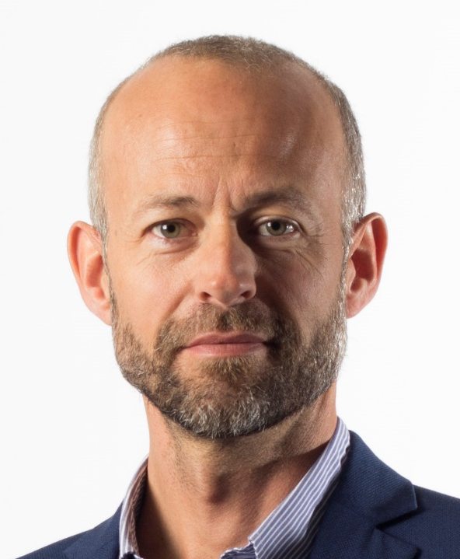
SESAME II Human Factors team
Prof. Margareta Lötzhöft
Prof. Thomas Porathe
Associate prof. Marius Imset

Slide 17
A proposed solution: one system
Why should a ship share its route & ETA with its destination(s)?
Basis of a single (eco)system, initiating an automated process
Reporting points will be known
Services along the route can be identified and subscribed to
Arrival can be coordinated with berth availability and port services

Slide 18
Thank you for your attention

